Slide 1
From App to Web
Who am I?
Communicating with customers
Are apps all bad?
Learning from history and looking forward
Web as an alternative to app’s The two approaches.
Two demos along the way……

Slide 2
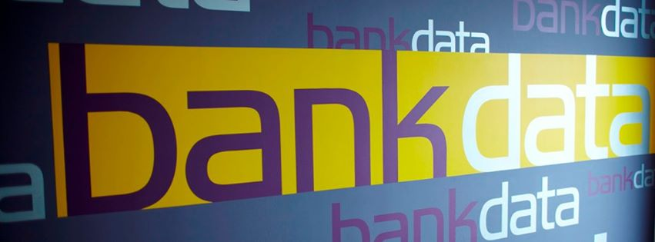
Who am I?

Slide 3
Communicating with customers
Stop !!!
I want an app that can...
What is it that you really what?
What is the actual problem that needs to be addressed?
Some of our salespeople have problems with…

Slide 4
Communicating with customers
He knows business
You know technology
Don't misguide each other

Slide 5
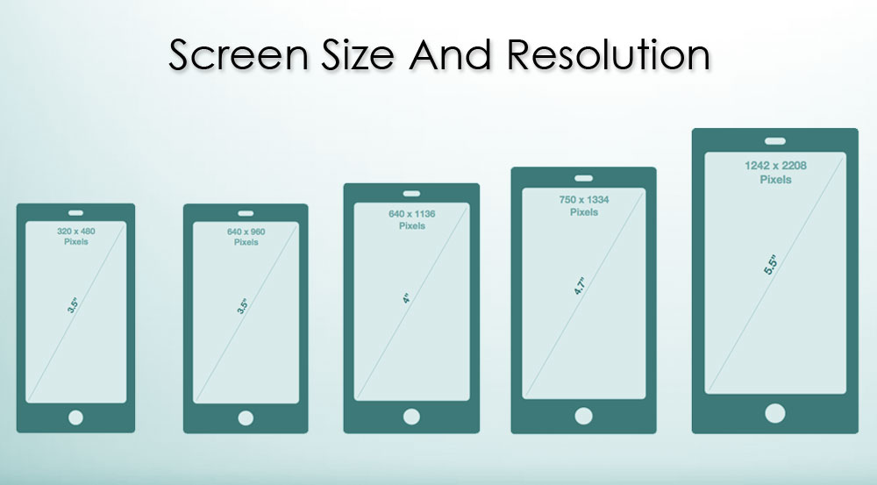
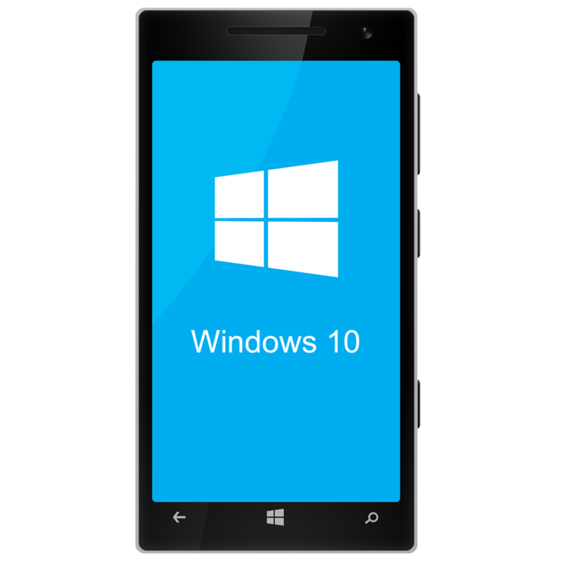
The problem with app’s

Slide 6
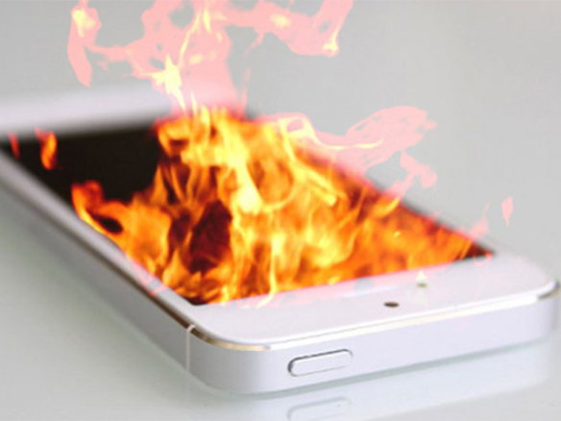
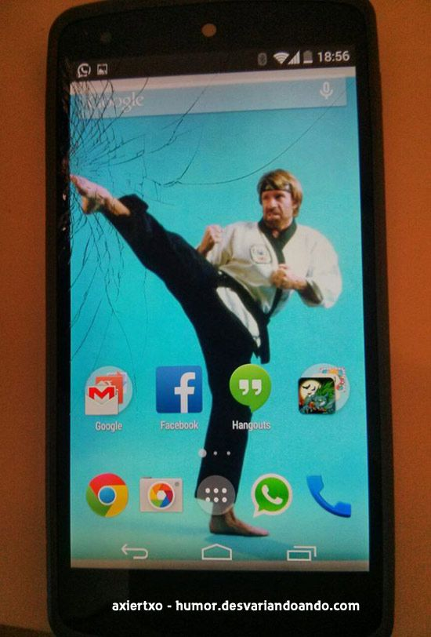
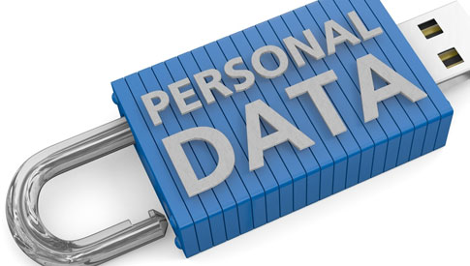
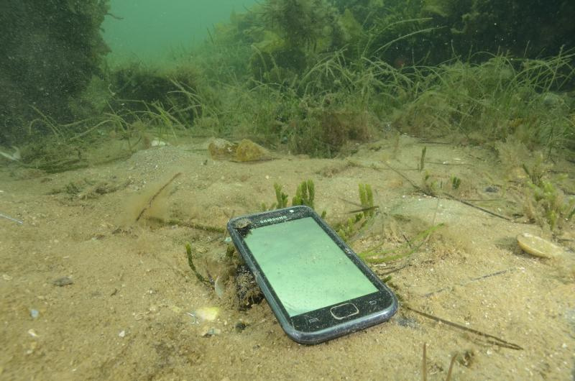
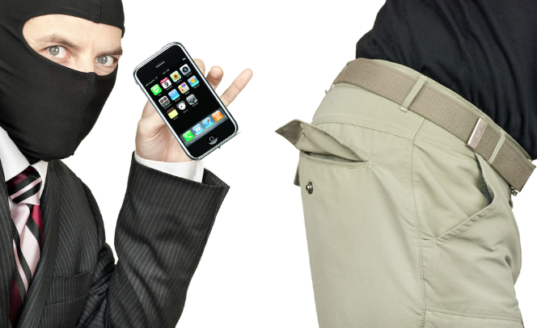
But where is my data?

Slide 7
Do we need to store data on our phone?

Slide 8
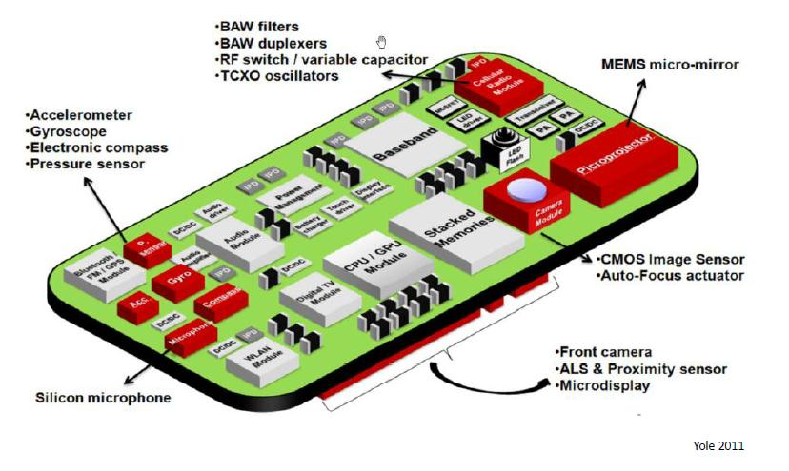
Aren't apps any good?

Slide 9
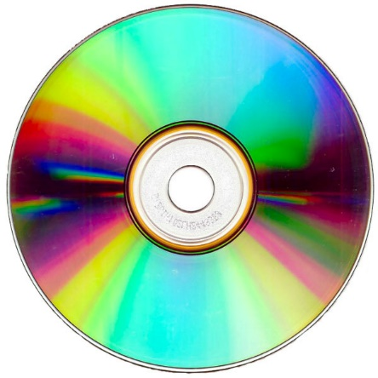
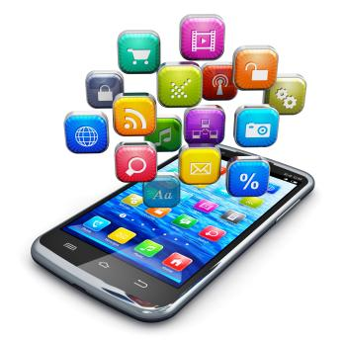
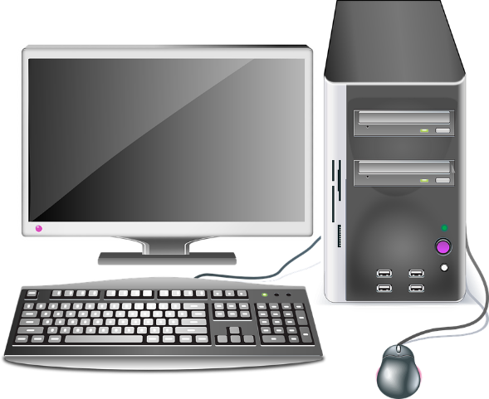
The evolution of internet
Installable programs
Web based applications
Portable devices
Stronger portable devices
Local installations can take advantages like cache and use local resources more efficient.
Web pages do not need local installations and are usually more flexible, but are not as efficient as they are scripted.
How much power does our device have?
How fast and reliable are this connection?

Slide 10
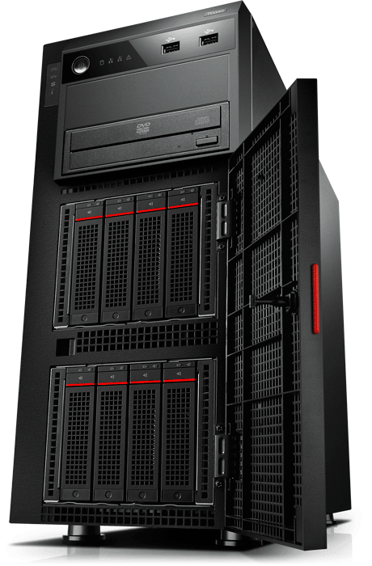
Ordinary web communication
Request
Response
Request
Response

Slide 11
Demo

Slide 12
Why is stateless a good thing
Request
Request
Response
Response
Request
Request
Response
Response

Slide 13
How may a web architecture look like?
External data
Front-end
Business tier
Login service

Slide 14
Still no look and feel of an app
AJAX = Asynchronous JavaScript And XML
Something changed?
No
Something changed?
No

Slide 15
How about... ?
Subscribe
Publish
Stateless connection

Slide 16
Demo

Slide 17
Conclusion
HTML5
https://www.html5rocks.com/en/features/offline
http://html5test.com/
http://www.w3schools.com/HTML/html5_geolocation.asp
Main goal: Can web replace apps?
What do we need to achieve this?
The "look and feel" of an app.
Quick response.
Data appear as being stored locally.
Benefit of using an web page instead of an app?
Easy to change device.
Data are "secure" away from the device.
Where are apps better?
High usage of sensors.
Unstable internet connection.

Slide 18
Questions….

